Slide 1

IMDB MOVIE ANALYSIS
BY SATHISH
DATA ANALYST
05/05/2024

Slide 2

Project Description
The objective of this project is to investigate and understand the reasons behind the success of movies on IMDB.

Slide 3

Approach
Data cleaning and wrangling
Identifying and Removing Irrelevant Columns ( From the perspective of the planned analysis)
Removed duplicate records.
Removed rows with potential null values with the view to maintain data quality and accuracy.
Calculated the profit for each movie by subtracting gross collection from the budget.
Assumption: Assumed columns that represents the currency are in terms of Rupees.

Slide 4
Tech Stacks Used
All the analysis process including data cleaning, manipulation, statistical analysis and visualizations are done using Microsoft Excel 365. Since dataset was small, and is in requirement of use of statistical analysis, I preferred Excel.
Microsoft PowerPoint – For the communication of the insights derived to the stake holders.

Slide 5

Insights

Slide 6

Movie Genre Analysis
Task: To determine most common genres of movies in the dataset and to calculate the descriptive statistics for the same.

Slide 7
Workings

Slide 8

Insights
If we go with the frequency, "Drama" is the most common genre with 1941 movies listed. The mean IMDB for the same is 6.79.
"Comedy" and "Thriller" are other common genres with 1504 and 1117 movies listed and with mean IMDB score of 6.18 and 6.38 respectively.
"Short" and "Film-Noir" are the least common genre with only 2 and 1 movies listed. The mean IMDB scores are 6.8 and 7.7 respectively.
The mean IMDB score of "Film-Noir" genre i.e., 7.7, is the highest mean IMDB score among others with only 1 movie listed.
"Horror" genre, with 391 movies listed, has the least mean IMDB score of 5.93.

Slide 9

Movie Duration Analysis
Task: To analyse the distribution of movie durations and identify the relationship between movie duration and IMDB score.

Slide 10
Workings
Calculation of Descriptive Statistics.

Slide 11
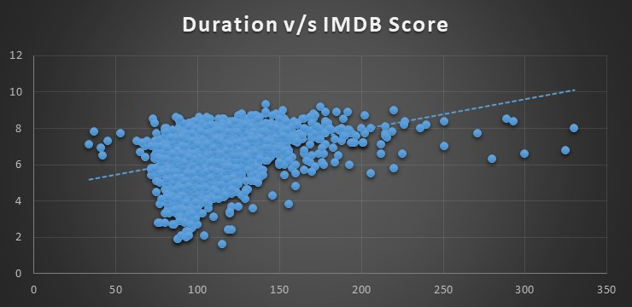
Workings
Visual representation of Duration and IMDB Score in order to understand the relationship between the same.

Slide 12
Insights
The above scatter plot along with the value of correlation coefficient suggest us that there is a weak positive correlation between movie length and IMDB score.
This means that longer movies tend to have slightly higher IMDB scores than shorter movies.
However, there is a lot of variation in the data, and there are many exceptions to this trend also.
Ultimately, it seems that movie length is not a very good predictor of how good a movie will be.

Slide 13

Movie Language Analysis
Task: To determine the most common languages used in movies and analyse their impact on the IMDB score using descriptive statistics.

Slide 14
Workings
Calculation of the mean, median, and standard deviation of the IMDB scores for each language.

Slide 15
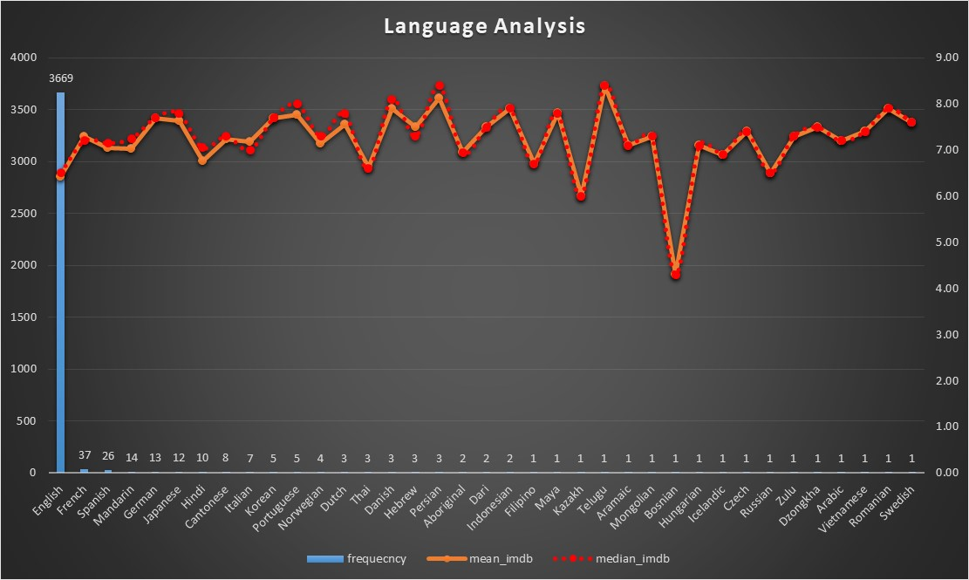
Workings
Visual representation of Frequency, mean and median.

Slide 16
Insights
"English" is the most popular language with total of 3669 movies listed and with the mean IMDB score of 6.42. Here, the mean and median values are almost similar with the standard deviation value of 1.05.
“Telugu” is the language with highest mean IMDB score of 8.40 with only 1 movie listed.
"French", "Spanish", "Mandarin", "German", "Japanese" are the languages with almost good number of movies listed and also with average IMDB around 7.34 and also with standard deviation below 1.
"Filipino", "Maya", "Kazakh", "Telugu", "Aramaic", "Mongolian", "Bosnian", "Hungarian", "Icelandic", "Czech", "Russian", "Zulu", "Dzongkha", "Arabic", "Vietnamese", "Romanian", "Swedish" are the languages with lowest listed movies of 1 and the average IMDB of 7.08.
The lowest IMDB mean is 4.30 which is of "Bosnian" language with only 1 movie listed.
The correlation coefficient of the frequency and the mean is -0.192968.
This means that there is a slight tendency for the two variables to move in opposite directions (i.e., when the frequency increases the mean IMDB score decreases), but the relationship is not very strong.

Slide 17
Director Analysis
Task: Identify the top directors based on their average IMDB score and analyse their contribution to the success of movies using percentile calculations.

Slide 18
Workings
Calculation of 90th percentile based on the “mean_imdb” ( the calculation of “mean_imdb” score of each director is not included here as it exceeds more than 1000 rows. Please refer the attached link at the end of this file to access the Excel file having detailed calculations) of each directors.

Slide 19
Workings
The value of 90th percentile is 7.5. This means 90% of the total average IMDB scores falls below 7.5 and only 10% of the average IMDB scores are above this value.
I consider the directors who falls under this 10% and who have more than 1 movie listed as the top directors.

Slide 20
Workings
Visual representation of Top Directors.

Slide 21

Insights
"Christopher Nolan", "Sam Mendes" has the highest “mean_imdb” score of 8.43 with 3 and 8 movies listed respectively.
The maximum number movies listed within the top directors list is 25, which is of director "Rob Marshall" with “mean_imdb” score of 7.54.
The correlation coefficient value between the frequency and “mean_imdb” is -0.0478, which indicates a slight negative correlation between the same.

Slide 22

Budget Analysis
Task: Understanding the relationship between movie budgets and their financial success.

Slide 23
Workings
Calculation of Correlation Coefficient between “Budget” and “Gross Earnings”.

Slide 24
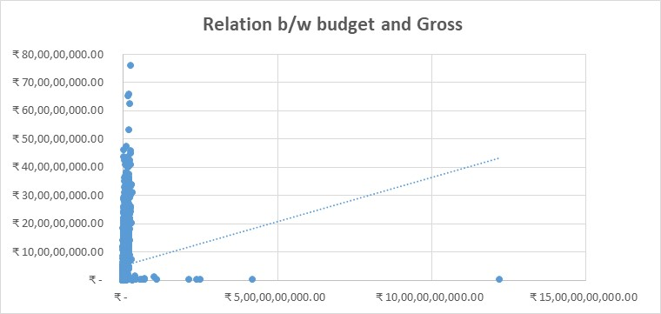
Workings
Scatterplot showing the relationship between Budget and Gross Earnings.

Slide 25

Insights
The correlation coefficient between the budget and the gross earnings of movies is 0.1009.
As the value is almost equals to 0, it is clear that there is no direct relationship between the budget and the gross collection.

Slide 26
Profit Analysis
Task: To calculate the profit margin (gross earnings - budget) for each movie and identify the movies with the highest profit margin.

Slide 27
Workings
Calculation of Top 5 movies having highest profits.

Slide 28
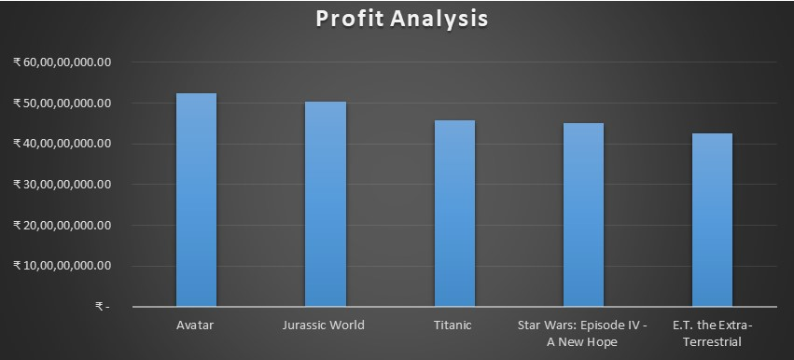
Workings
Visual representation of Top 5 movies having highest profits.

Slide 29
Insights
"Avatar" is the most profitable movie with total profit of Rs.52,35,05,847.
"Jurassic World ","Titanic ","Star Wars: Episode IV - A New Hope ","E.T. the Extra-Terrestrial " are other movies which falls under the top 5 profitable movies.

Slide 30

Critic Analysis
Task: To understand the relationship between “num_critic_for_reviews” and “imdb_score”.

Slide 31
Workings
Calculation of correlation coefficient between “num_critic_for_reviews” and “imdb_score”.

Slide 32
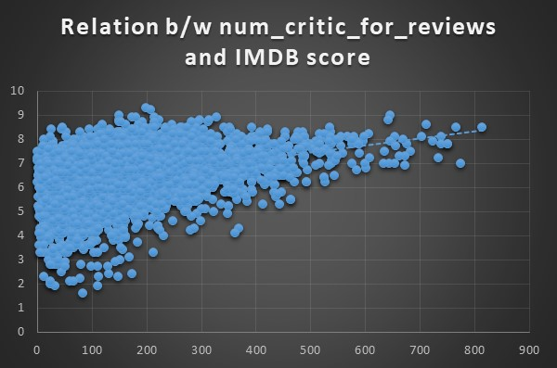
Workings
Scatter plot to show the graphical representation of the relationship between the “num_critic_for_reviews” and “imdb_score”.

Slide 33

Insights
The correlation coefficient between the “num_critic_for_reviews” and “IMDB score” is 0.3204.
This, along with the scatter plot, reveals that there is a slight positive correlation between the “critic_for_reviews” and the “imdb score”.

Slide 34

Voted Users Analysis
Task: To identify the relationship between the “number_of_voted_users” and “imdb_score”.

Slide 35
Workings
Calculation of Correlation Coefficient between “number_of_voted_users” and “imdb_score”

Slide 36
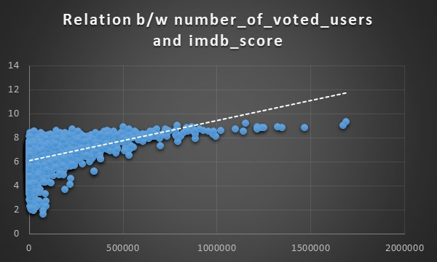
Workings
Scatter plot visualizing the relationship between the “number_of_voted_users” and “imdb_score”.

Slide 37
Workings
Calculation of Correlation Coefficient between “number_of_voted_users” and “gross_collection”.

Slide 38
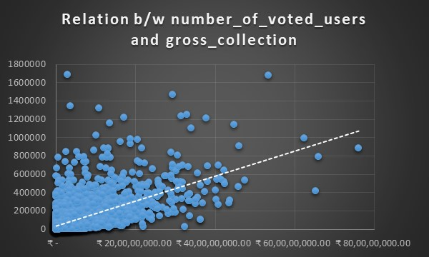
Workings
Scatter plot visualizing the “number_of_voted_users” and “gross_collection”.

Slide 39

Insights
Based on the Correlation Coefficient and the scatter plot, it is evident that there is a strong positive correlation between the “number_of_voted_users” and “imdb_score”.
Also, the relationship between the “nubmer_of_voted_users” and the “gross_collection” is direct and strongly positive.

Slide 40

Conclusion
Based on the above analysis, it is clear that the success of a movie is dependent on, not just one but, many factors such as budget, genre, duration, language, director, actors, number of people voted etc.

Slide 41
THANK YOU
Feel free to access the excel file that I worked : Link
sathishgudri@gmail.com

